Slide 1
GDHP Interoperability Workstream
IPS Work Group Meeting
April 27, 2023

Slide 2
Meeting Agenda
Agenda Item | Facilitator(s)
Opening Remarks (2 minutes) | Matt Rahn, Deputy Director of Standards Division, ONC, USA
HIMSS23 Recap (15 minutes) | John D’Amore, President of More Informatics & GDHP Interoperability Work Stream Contractor Jürgen Brandstätter, Deputy Co-Chair IHE-Europe & Austria GDHP representative
HL7 Connectathon Planning (10 minutes) | John D’Amore, President of More Informatics & GDHP Interoperability Work Stream Contractor Rob Hausam, IPS Editor, Hausam Consulting
Mini-Connectathon Planning (5 minutes) | All GDHP Participants
Open Discussion (10 minutes) | All GDHP Participants
Next Steps & Meeting Closure (3 minutes) | Aisha Hasan, Head of Global Health IT, ONC, USA

Slide 3
Opening Remarks
Matthew Rahn,
Deputy Director of Standards Division, ONC, USA

Slide 4
Recap of HIMSS 2023 (Chicago)
John D’Amore, President of More Informatics & GDHP Interoperability Work Stream Contractor
Jürgen Brandstätter, Deputy Co-Chair IHE-Europe & Austria GDHP representative

Slide 5



HIMSS Presentations on IPS
Tuesday April 18
Listening Session
2:00pm
Tuesday April 18
Panel Presentation
4:15pm
Wednesday April 19
Booth Presentation
2:50pm
Thursday April 20
Educational Session
10:00am

Slide 6
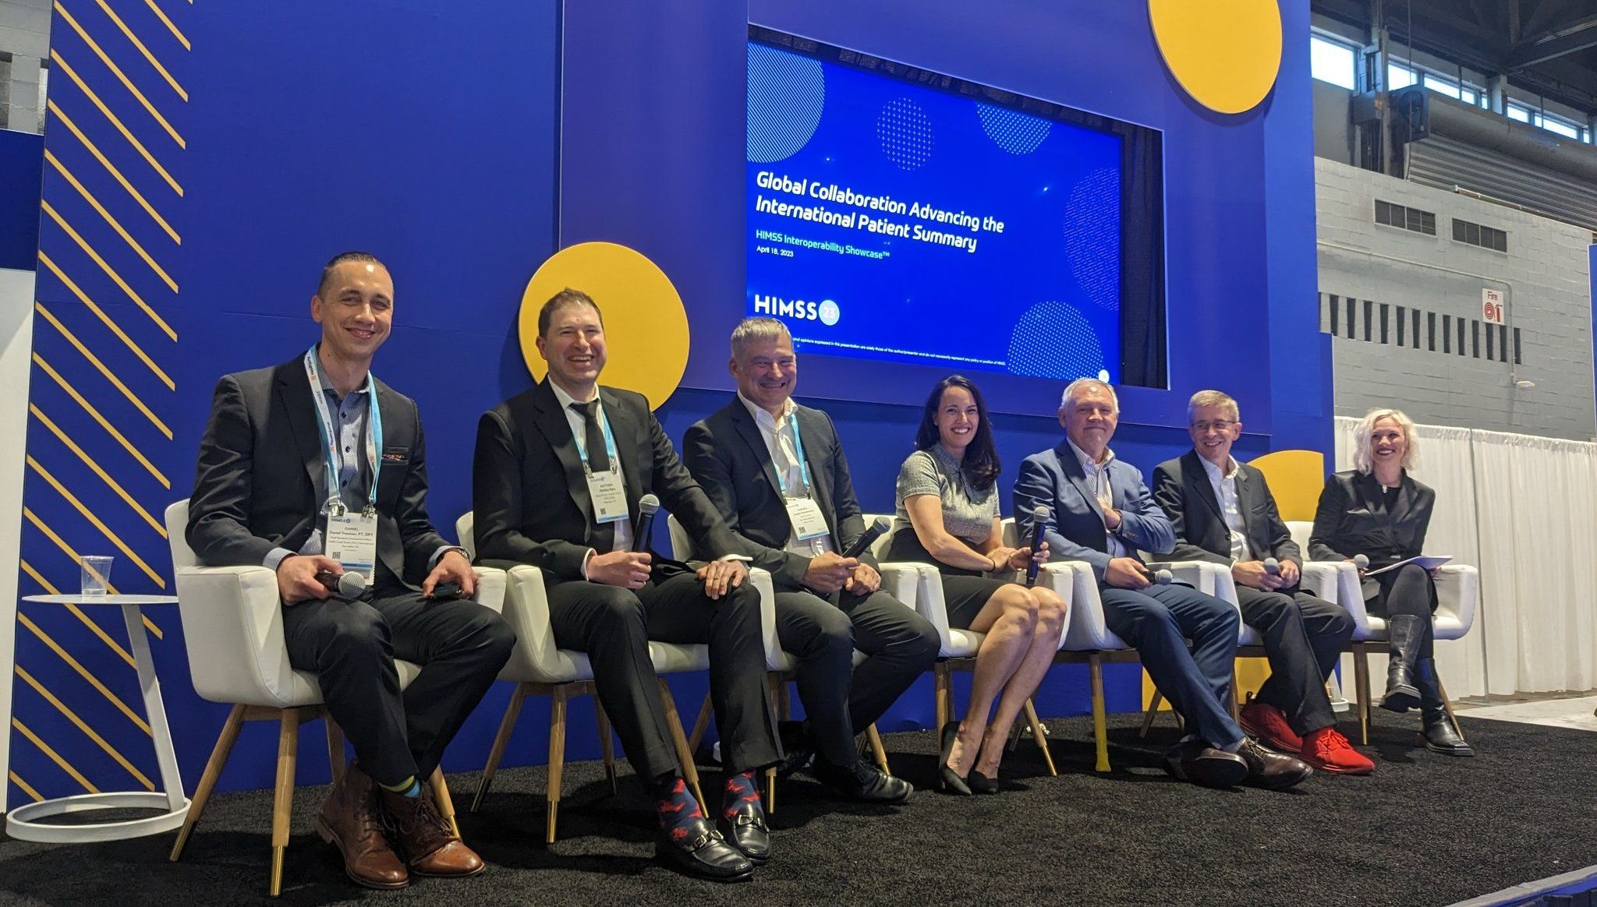
IPS Panel Presentation

Slide 7
IPS Listening Session
Participants
Jurgen Brandstätter
Christina Caraballo (Moderator/Host)
Attila Farkas
Eli Fleet
Andrea K. Fourquet
Andreas Klingler
John Moehrke
Matthew Rahn
Derek Ritz
Suzy Roy
Amit Trivedi
Dan Vreeman
Lapo Bertini
Notable Topics
Global review of progress
How to approach regionalization of IPS?
Complexities of document exchange
IPS in larger context of data exchange
SMART guidelines from WHO
Data quality remains an issue
Fallback/maintenance of human readability
Discussion on Netherlands as GDHP lead
Importance of Cross-SDO collaboration
Rough transcript available on request

Slide 8
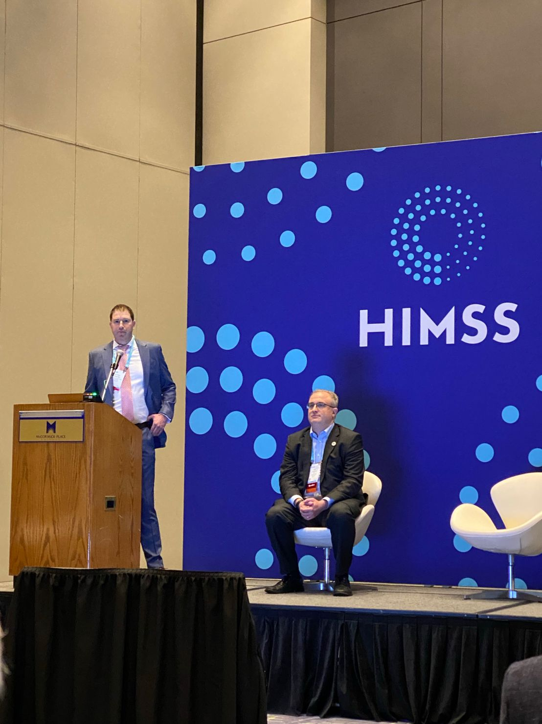
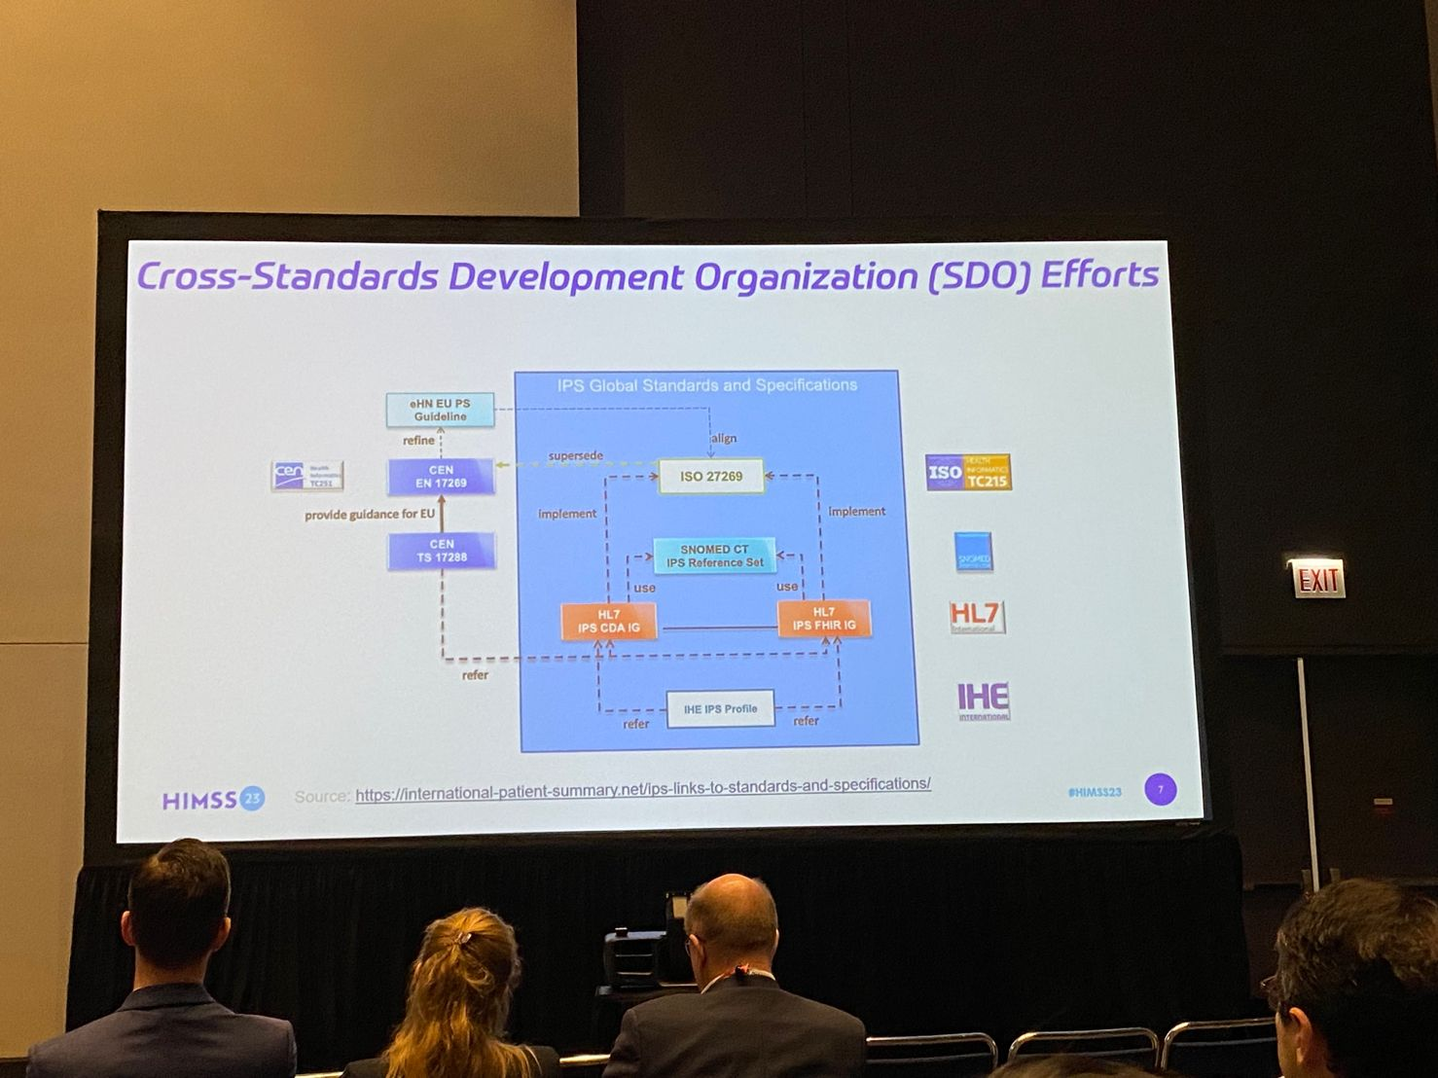
Global Advancements in IPS

Slide 9

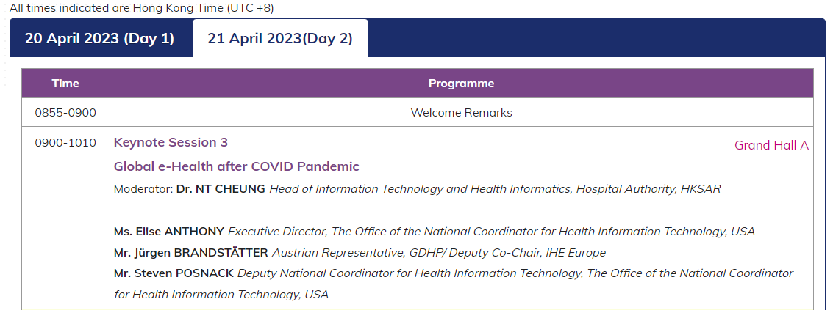
Asia Pacific eHealth Conference

Slide 10
HL7 Connectathon Planning
John D’Amore, President of More Informatics & GDHP Interoperability Work Stream Contractor
Rob Hausam, Hausam Consulting

Slide 11
HL7 IPS Track FHIR Connectathon 33 (May 6-7)
Track Kickoff (before connectathon):
Friday April 28, 3pm ET Zoom Link: https://us06web.zoom.us/j/84161506010?pwd=WW44TkNhTFB2WjN5NmNFOFRyTlFJZz09&from=addon
Event agenda
Saturday May 6, 10:00-11:00am CT Joint Session with IPA/IPS
Saturday May 6, 3:00-4:00pm SMART Health Link & IPS Demonstration (tentative)
Sunday May 7, 10:00-12:00pm CT National IG Joint Session with IPA/IPS

Slide 12







Attendees of IPS Track (Tentative)
Currently have 10+ registered track attendees from 7 nations

Slide 13
Scenarios for May FHIR Connectathon IPS Track
https://confluence.hl7.org/display/FHIR/2023+-+05+International+Patient+Summary
Generator of IPS documents (such as personal health records, health information exchanges or electronic health records)
Patient mediators of IPS document exchange, particularly mobile devices with QR code wallets
Consumer of IPS Documents: Retrieves a FHIR IPS document and/or individual component resource instances created by the Document Creator from the FHIR server and does one or more of the following:
validates the document and/or component resource instances against the IPS Clinical Document profile,
displays the document and/or discrete data components in a browser (or by other means),
translates the coded and/or narrative data to a different language for display, or
translates the coded data to different code system(s) used in a jurisdiction that is different from the source.
Will include testing of SMART Health Links to facilitate Patient Mediated IPS Exchange

Slide 14


HL7 WGM+: IPS Main Stage
Wednesday May 10 3:30pm CT
International Patient Summary (John D & Matt R)
European Health Data Space and FHIR for Lab Reports (Jurgen B & Giorgio C)
Hilton Riverside New Orleans

Slide 15
Mini-Connectathon Planning
All GDHP Participants

Slide 16

GDHP Mini-Connectathon WILL BE VIRTUAL ONLY
Monday June 12
Tuesday June 13
Wednesday June 14
Thursday June 15
Friday June 16
Unavailable
Potential Date
Potential Date
Monday June 19
Tuesday June 20
Wednesday June 21
Thursday June 22
Friday June 23
Potential Date
11th Summit
Washington, DC
Demo(s) from Mini-Connectathon to be shown at Summit

Slide 17
Open Discussion
All GDHP Participants

Slide 18
Closing Remarks
Aisha Hasan,
Head of Global Health IT, ONC, USA

Slide 20
Appendix

Slide 21
IPS Work Group Approved Items
These items have been approved by the GDHP Interoperability Work Stream’s IPS Work Group.
Please let Matt Rahn & Aisha Hasan (Matthew.Rahn@hhs.gov, Aisha.Hasan@hhs.gov & ONCGlobalHealthIT@hhs.gov) know if you have additional feedback to be included in these items.

Slide 22
IPS Policy, Legal, and Cyber Security Implications
During the April 1, 2021 meeting, the GDHP Interoperability Work Stream’s IPS Work Group decided to advance the IPS standard via patient-mediated exchange for piloting and production.
Please let Matt Rahn & Aisha Hasan (Matthew.Rahn@hhs.gov, Aisha.Hasan@hhs.gov & ONCGlobalHealthIT@hhs.gov) know if your nation has any obstacles or challenges for this path forward.

Slide 23
IPS Use Cases
Document bundle for cross-border (international) data exchange
Cross-border exchange infrastructure (e.g., European cross-border exchange)
Mobile devices
Transfer of Care
Referral to specialist
IPS profiles used as a foundation for other specialized specifications
Regional, national, local patient summaries
Vaccination data (for COVID-19 or future pandemics)
Cancer survivorship passport
Rare diseases (notification/awareness?)
Please let Matt Rahn & Aisha Hasan (Matthew.Rahn@hhs.gov, Aisha.Hasan@hhs.gov & ONCGlobalHealthIT@hhs.gov) know if there are additional use cases that should be included here.

Slide 24
Key Steps for GDHP Members’ Implementation of IPS
Steps (can occur concurrently) | Leads
1. Identify GDHP members that will participate in the 2021 pilot projects and the next wave of 2022 production or pilot projects | GDHP IPS Work Group
2. Determine IPS health data flow within the nation for GDHP members with multiple provinces/states. | GDHP IPS Work Group Members (as applicable)
3. Discuss each GDHP members’ local infrastructure to build on to use IPS in a local setting for a non-resident and generate IPS from the individuals’ primary health care provider’s EHR | Each GDHP member for their nation. Each GDHP member will present on this during an IPS Work Group meeting.
4. Conduct a broad gap analysis between the IPS and each GDHP members’ local infrastructure specifications. Determine to what extent the requirements of the IPS can be met by the local infrastructure. | Each GDHP member for their respective nation. Each GDHP member will provide feedback during IPS Work Group meetings.
5. Identify each GDHP members’ local infrastructure to be used to exchange the IPS (e.g., national contact point, personal mobile device). | Each GDHP member for their nation
6. Identify and address GDHP members’ local infrastructure, security, consent, authentication, policy, etc. constraints to exchanging the IPS. | GDHP IPS Work Group
7. Identify GDHP members who will participate in the 2021 pilots. GDHP members will have a better understanding of the time commitment to engage in a pilot project and to move to production. | GDHP IPS Work Group
8. Update the IPS based on pilot testing to ensure better alignment and exchange of data within the IPS standard. | GDHP IPS Work Group

Slide 25
IPS Success
GDHP members agree on path for IPS implementation globally, and each member implements IPS in their nation.
IPS is implemented so individuals’ health data is available and usable by the local health care provider and health system for providing care to the individual in another nation.
The local health care provider and health system are able to provide the individual with an updated IPS record, including the data from the care they received in-country.
Individuals’ primary health care providers can readily and easily generate an IPS document or specialized subset (e.g., vaccination record) based on the individuals’ clinical data in the EHR.
Individuals’ IPS records are provided, or easily accessible, to them by a cross-border health care provider as needed.
Individuals can carry their health data in an IPS document (or specialized subset) on their electronic (mobile) device.
Nations without information health systems can easily access their IPS records via paper formats.
GDHP nations agree on IPS maintenance of health data standards and mapping, and they implement it globally and in their nations.
GDHP nations agree on individuals’ patient consent authentication when sharing data across borders.

Slide 26
IPS Work Group Goals
End of 2021: At least 10 countries and territories are able to exchange and use IPS data with one or more other country(ies) in a pilot project.
End of 2022: At least 20 countries and territories are able to exchange and use IPS data with one or more other country(ies) in production (at least 10 countries) and the remaining countries in pilot use.
Ultimate Goal: All GDHP countries and territories are able to exchange and use IPS data.
IPS Work Group Goals
This may undergo an update based on Interoperability workstream feedback

Slide 27
IPS Work Group Milestones
IPS Work Group Milestones
2021:
Connectathons – IPS Tracks
Jan 2021 HL7 FHIR Connectathon
Mar 2021: IHE NA Connectathon
May 2021: HL7 FHIR Connectathon
May 2021: GDHP FHIR Connectathon
Jun 2021: GDHP FHIR Connectathon
Sep 2021: HL7 FHIR Connectathon
Oct 2021: GDHP FHIR Connectathon
Present on the IPS
Apr 2021: GDHP Summit
Aug 2021: HIMSS Conference
Nov 2021: SNOMED International
.
Demos & Articles
HL7 Blog
IPS Viewer Hosted (www.ipsviewer.com)
UK IPS Prototype Development
2022:
Connectathons – IPS Tracks
Jan 2022: GDHP FHIR Connectathon
Mar 2022: Canadian Projectathon (IPS-related)
Apr 2022: Trans-Tasman Event (IPS-related)
May 2022: HL7 FHIR Connectathon
May 2022: LACPass Connectathon (IPS-related)
June 2022: GDHP FHIR Connectathon
Sep 2022: IHE & HL7 Testing & Connectathon
Nov 2022: GDHP Connectathon (TBD)
Present on the IPS
Mar 2022 HIMSS Presentation
Jun 2022 HL7 FHIR DevDays
September 2022: SNOMED International
Demos & Articles
Healthcare Journal Publication
Demo (ips.health) at 2022 GDHP Summit
Notes:
2021 and 2022 have been very busy years in terms of advancing IPS. As a summary
Support for 5 GDHP mini-connectathons
Support for 5 HL7 multi-day connectathons (counting September 2022)
Major presentation at national and international conferences
The advancement of demos, tools, events and prototypes through many global partners

